Slide 1
ASE Scenarios
Scenario 1
ASE User creates new ASE Project

Slide 2
Roles
Engineer
Risk Manager

Slide 3
Goals
Setup a project and ASE profile for the Test Application in order to discover it’s attack surface

Slide 4
Steps
Step 1: Create a New ASE Project and Profile
Step 2: Define Properties for the ASE Profile

Slide 5
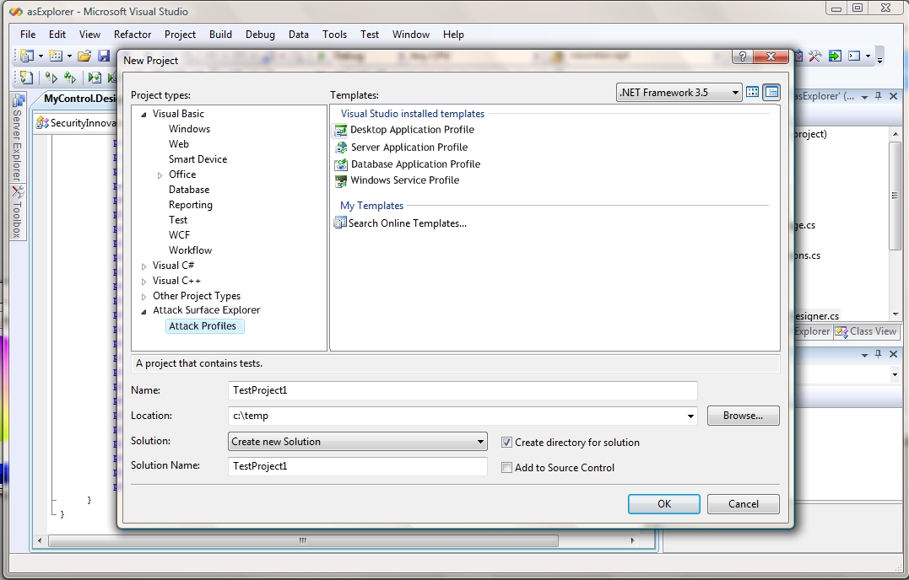
Step 1
Create a New ASE Project and Profile
Using the Visual Studio New Project Dialog
User specifies a profile type to use
User can add more profiles to this ASE project later

Slide 6
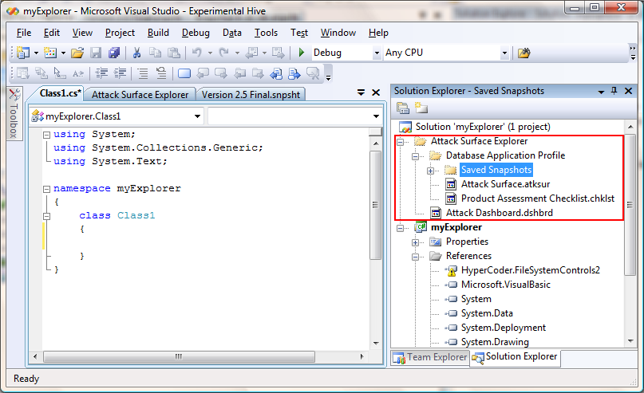
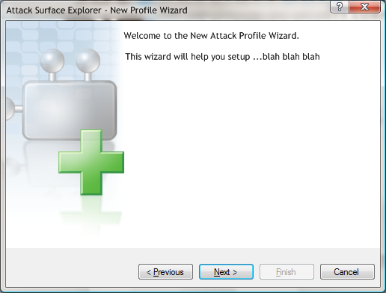
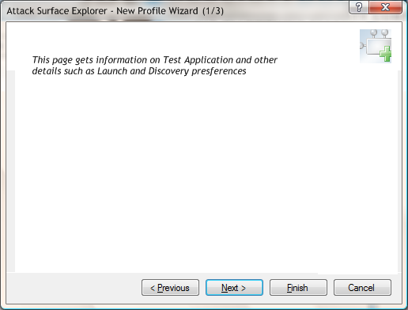
Step 2
Define Properties for the ASE Profile
Using New Profile Wizard
User specifies details of Test Application
Other preferences (such as launch conditions etc)

